Slide 1
Adaptive email client app
T.Jesika

Slide 2
DESCRIPTION
Auto-Suggested Responses: Provides intelligent, context-based response suggestions for quick replies to frequently asked questions or updates.
Adaptive Mail app is a sample project that demonstrates how to use the Android Compose UI toolkit to build a conversational UI. The app simulates a messaging interface, allowing the user to send and receive messages, and view a history of previous messages. It showcases some of the key features of the Compose UI toolkit, data management, and user interactions
Smart Inbox Filtering: Uses AI to categorize emails by priority, such as “Urgent,” “Follow-up,” and “Social.” Over time, it learns which contacts and topics are most relevant to you.
Adaptive Notifications: Prioritizes alerts based on urgency and relevance, ensuring you're notified of high-priority emails without constant interruptions.
Integrated Calendar & Task Management: Recognizes deadlines and reminders from emails, automatically creating tasks and events for better scheduling and time management.
Efficient Search: Uses advanced search filters and natural language processing to quickly locate emails, contacts, and attachments

Slide 3
Main Activity:
package com.example.emailapplication
import android.content.Context
import android.content.Intent
import android.os.Bundle
import androidx.activity.ComponentActivity
import androidx.activity.compose.setContent
import androidx.compose.foundation.Image
import androidx.compose.foundation.background
import androidx.compose.foundation.layout.*
import androidx.compose.material.*
import androidx.compose.runtime.Composable
import androidx.compose.ui.Alignment
import androidx.compose.ui.Modifier
import androidx.compose.ui.graphics.Color
import androidx.compose.ui.layout.ContentScale
import androidx.compose.ui.res.painterResource
import androidx.compose.ui.text.font.FontWeight
import androidx.compose.ui.tooling.preview.Preview
import androidx.compose.ui.unit.dp

Slide 4
import androidx.compose.ui.unit.sp
import androidx.core.content.ContextCompat
import androidx.core.content.ContextCompat.startActivity
import com.example.emailapplication.ui.theme.EmailApplicationTheme
class MainActivity : ComponentActivity() {
override fun onCreate(savedInstanceState: Bundle?) {
super.onCreate(savedInstanceState)
setContent {
// A surface container using the 'background' color from the theme
Surface(
modifier = Modifier.fillMaxSize().background(Color.White),
) {
Email(this)
}
}
}
}

Slide 5
@Composable
fun Email(context: Context) {
Text(
text = "Home Screen",
modifier = Modifier.padding(top = 74.dp, start = 100.dp, bottom = 24.dp),
color = Color.Black,
fontWeight = FontWeight.Bold,
fontSize = 32.sp
)
Column(
horizontalAlignment = Alignment.CenterHorizontally,
verticalArrangement = Arrangement.Center
) {
Image(
painterResource(id = R.drawable.home_screen), contentDescription = ""
) Button(onClick = {
context.startActivity(
Intent(
context,
SendMailActivity::class.java
)
)
},

Slide 6
colors = ButtonDefaults.buttonColors(backgroundColor = Color(0xFFadbef4))
) {
Text(
text = "Send Email",
modifier = Modifier.padding(10.dp),
color = Color.Black,
fontSize = 15.sp
)
}
Spacer(modifier = Modifier.height(20.dp))
Button(onClick = {
context.startActivity(
Intent(
context,
ViewMailActivity::class.java
)
)
},
colors = ButtonDefaults.buttonColors(backgroundColor = Color(0xFFadbef4))
) {Text(
text = "View Emails",
modifier = Modifier.padding(10.dp),
}

Slide 7
LoginActivity.kt
package com.example.emailapplication
import android.content.Context
import android.content.Intent
import android.os.Bundle
import androidx.activity.ComponentActivity
import androidx.activity.compose.setContent
import androidx.compose.foundation.Image
import androidx.compose.foundation.background
import androidx.compose.foundation.layout.*
import androidx.compose.material.*
import androidx.compose.runtime.*
import androidx.compose.ui.Alignment
import androidx.compose.ui.Modifier
import androidx.compose.ui.graphics.Color
import androidx.compose.ui.layout.ContentScale
import androidx.compose.ui.res.painterResource
import androidx.compose.ui.text.font.FontFamily
import androidx.compose.ui.text.font.FontWeight
import androidx.compose.ui.text.input.PasswordVisualTransformation
import androidx.compose.ui.tooling.preview.Preview
import androidx.compose.ui.unit.dp
import androidx.compose.ui.unit.sp
import androidx.core.content.ContextCompat

Slide 8
{ Text(color = Color(0xFF31539a),text = "Sign up") }
TextButton(onClick = {
})
{
Spacer(modifier = Modifier.width(60.dp))
Text(color = Color(0xFF31539a),text = "Forget password?")
}
}
}
}
private fun startMainPage(context: Context) {
val intent = Intent(context, MainActivity::class.java)
ContextCompat.startActivity(context, intent, null)
}
xmActivity_main. l:
package com.example.emailapplication
import android.content.Context

Slide 9
import android.content.Intent
import android.os.Bundle
import androidx.activity.ComponentActivity
import androidx.activity.compose.setContent
import androidx.compose.foundation.Image
import androidx.compose.foundation.background
import androidx.compose.foundation.layout.*
import androidx.compose.material.*
import androidx.compose.runtime.Composable
import androidx.compose.ui.Alignment
import androidx.compose.ui.Modifier
import androidx.compose.ui.graphics.Color
import androidx.compose.ui.layout.ContentScale
import androidx.compose.ui.res.painterResource
import androidx.compose.ui.text.font.FontWeight
import androidx.compose.ui.tooling.preview.Preview
import androidx.compose.ui.unit.dp
import androidx.compose.ui.unit.sp
import androidx.core.content.ContextCompat
import androidx.core.content.ContextCompat.startActivity
import com.example.emailapplication.ui.theme.EmailApplicationTheme

Slide 10
class MainActivity : ComponentActivity() {
override fun onCreate(savedInstanceState: Bundle?) {
super.onCreate(savedInstanceState)
setContent {
// A surface container using the 'background' color from the theme
Surface(
modifier = Modifier.fillMaxSize().background(Color.White),
) {
Email(this)
}
}
}
}
@Composable
fun Email(context: Context) {
Text(
text = "Home Screen",
modifier = Modifier.padding(top = 74.dp, start = 100.dp, bottom = 24.dp),
color = Color.Black,

Slide 11
fontWeight = FontWeight.Bold,
fontSize = 32.sp
)
Column(
horizontalAlignment = Alignment.CenterHorizontally,
verticalArrangement = Arrangement.Center
) {
Image(
painterResource(id = R.drawable.home_screen), contentDescription = ""
)
Button(onClick = {
context.startActivity(
Intent(
context,
SendMailActivity::class.java
)
)
},
colors = ButtonDefaults.buttonColors(backgroundColor = Color(0xFFadbef4))
) {

Slide 12
Text(
text = "Send Email",
modifier = Modifier.padding(10.dp),
color = Color.Black,
fontSize = 15.sp
)
}
Spacer(modifier = Modifier.height(20.dp))
Button(onClick = {
context.startActivity(
Intent(
context,
ViewMailActivity::class.java
)
)
},
colors = ButtonDefaults.buttonColors(backgroundColor = Color(0xFFadbef4))
) {
Text(
text = "View Emails",
modifier = Modifier.padding(10.dp),
}

Slide 13
AndroidManifest.xml
<?xml version="1.0" encoding="utf-8"?>
<manifest xmlns:android="http://schemas.android.com/apk/res/android"
xmlns:tools="http://schemas.android.com/tools" >
<application
android:allowBackup="true"
android:dataExtractionRules="@xml/data_extraction_rules"
android:fullBackupContent="@xml/backup_rules"
android:icon="@mipmap/ic_launcher"
android:label="@string/app_name"
android:supportsRtl="true"
android:theme="@style/Theme.EmailApplication"
tools:targetApi="31" >
<activity
android:name=".RegisterActivity"
android:exported="false"
android:label="@string/title_activity_register"
android:theme="@style/Theme.EmailApplication" />
<activity

Slide 14
android:name=".RegisterActivity"
android:exported="false"
android:label="@string/title_activity_register"
android:theme="@style/Theme.EmailApplication" />
<activity
android:name=".MainActivity"
android:exported="false"
android:label="MainActivity"
android:theme="@style/Theme.EmailApplication" />
<activity
android:name=".ViewMailActivity"
android:exported="false"
android:label="@string/title_activity_view_mail"
android:theme="@style/Theme.EmailApplication" />
<activity
android:name=".SendMailActivity"
android:exported="false"
android:label="@string/title_activity_send_mail"
android:theme="@style/Theme.EmailApplication" />
<activity
android:name=".LoginActivity"
android:exported="true"
android:label="@string/app_name"
android:theme="@style/Theme.EmailApplication" >

Slide 15
<action android:name="android.intent.action.MAIN" />
<category android:name="android.intent.category.LAUNCHER" />
</intent-filter>
</activity>
</application>
</manifest>
<?xml version="1.0" encoding="utf-8"?><!--
Sample backup rules file; uncomment and customize as necessary.
See https://developer.android.com/guide/topics/data/autobackup
for details.
Note: This file is ignored for devices older that API 31
See https://developer.android.com/about/versions/12/backup-restore
-->
<full-backup-content>
<!--
<include domain="sharedpref" path="."/>
<exclude domain="sharedpref" path="device.xml"/>
-->
</full-backup-content>

Slide 16
<?xml version="1.0" encoding="utf-8"?><!--
Sample data extraction rules file; uncomment and customize as necessary.
See https://developer.android.com/about/versions/12/backup-restore#xml-changes
for details.
-->
<data-extraction-rules>
<cloud-backup>
<!-- TODO: Use <include> and <exclude> to control what is backed up.
<include .../>
<exclude .../>
-->
</cloud-backup>
<!--
<device-transfer>
<include .../>
<exclude .../>
</device-transfer>
-->
</data-extraction-rules>
<vector xmlns:android="http://schemas.android.com/apk/res/android"
xmlns:aapt="http://schemas.android.com/aapt"
android:width="108dp"
android:height="108dp"
android:viewportWidth="108"
android:viewportHeight="108">

Slide 17
<vector xmlns:android="http://schemas.android.com/apk/res/android"
xmlns:aapt="http://schemas.android.com/aapt"
android:width="108dp"
android:height="108dp"
android:viewportWidth="108"
android:viewportHeight="108">
<path android:pathData="M31,63.928c0,0 6.4,-11 12.1,-13.1c7.2,-2.6 26,-1.4 26,-1.4l38.1,38.1L107,108.928l-32,-1L31,63.928z">
<aapt:attr name="android:fillColor">
<gradient
android:endX="85.84757"
android:endY="92.4963"
android:startX="42.9492"
android:startY="49.59793"
android:type="linear">
<item
android:color="#44000000"
android:offset="0.0" />
<item
android:color="#00000000"
android:offset="1.0" />
</gradient>
</aapt:attr>

Slide 18
</path>
<path
android:fillColor="#FFFFFF"
android:fillType="nonZero"
android:pathData="M65.3,45.828l3.8,-6.6c0.2,-0.4 0.1,-0.9 -0.3,-1.1c-0.4,-0.2 -0.9,-0.1 -1.1,0.3l-3.9,6.7c-6.3,-2.8 -13.4,-2.8 -19.7,0l-3.9,-6.7c-0.2,-0.4 -0.7,-0.5 -1.1,-0.3C38.8,38.328 38.7,38.828 38.9,39.228l3.8,6.6C36.2,49.428 31.7,56.028 31,63.928h46C76.3,56.028 71.8,49.428 65.3,45.828zM43.4,57.328c-0.8,0 -1.5,-0.5 -1.8,-1.2c-0.3,-0.7 -0.1,-1.5 0.4,-2.1c0.5,-0.5 1.4,-0.7 2.1,-0.4c0.7,0.3 1.2,1 1.2,1.8C45.3,56.528 44.5,57.328 43.4,57.328L43.4,57.328zM64.6,57.328c-0.8,0 -1.5,-0.5 -1.8,-1.2s-0.1,-1.5 0.4,-2.1c0.5,-0.5 1.4,-0.7 2.1,-0.4c0.7,0.3 1.2,1 1.2,1.8C66.5,56.528 65.6,57.328 64.6,57.328L64.6,57.328z"
android:strokeWidth="1"
android:strokeColor="#00000000" />
</vector>
<?xml version="1.0" encoding="utf-8"?>
<adaptive-icon xmlns:android="http://schemas.android.com/apk/res/android">
<background android:drawable="@drawable/ic_launcher_background" />
<foreground android:drawable="@drawable/ic_launcher_foreground" />
</adaptive-icon>

Slide 19
app:layout_constraintVertical_bias="0.78" />
<Button
android:id="@+id/button3"
android:layout_width="wrap_content"
android:layout_height="wrap_content"
android:text="Extras"
android:textStyle="bold"
app:layout_constraintBottom_toBottomOf="parent"
app:layout_constraintEnd_toEndOf="parent"
app:layout_constraintHorizontal_bias="0.913"
app:layout_constraintStart_toStartOf="parent"
app:layout_constraintTop_toTopOf="parent"
app:layout_constraintVertical_bias="0.669" />
</androidx.constraintlayout.widget.ConstraintLayout>

Slide 20
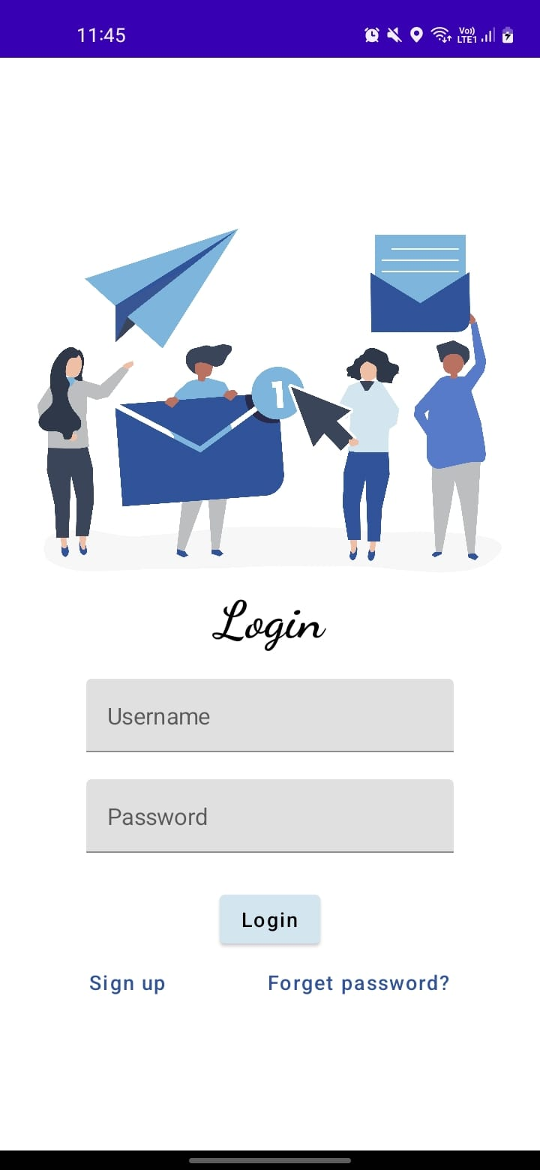
OUTPUT:

Slide 21
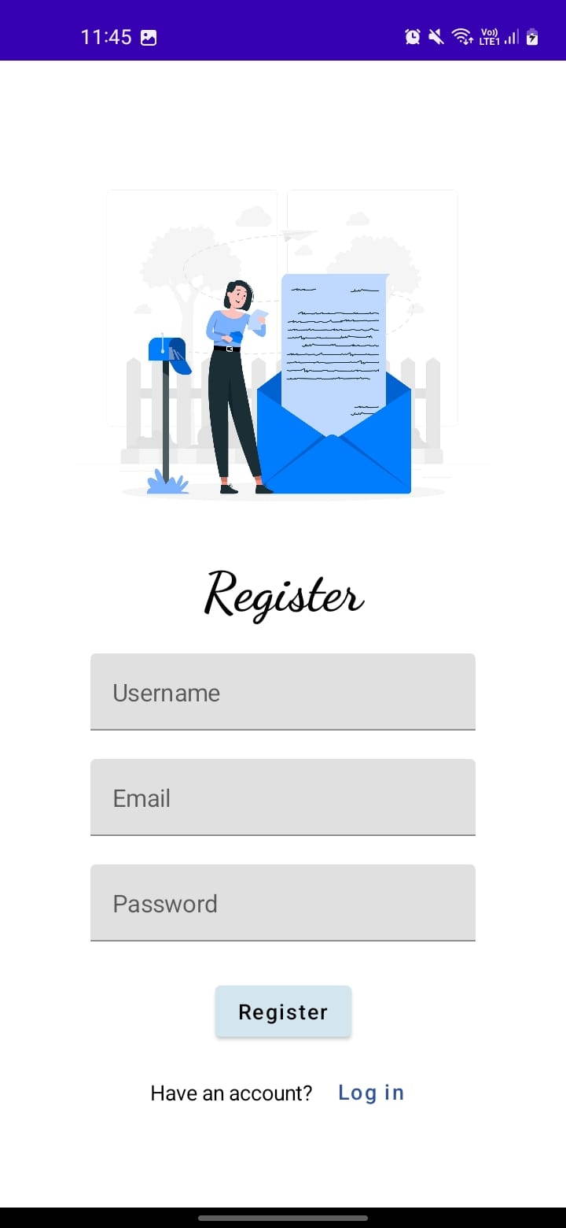

Slide 22
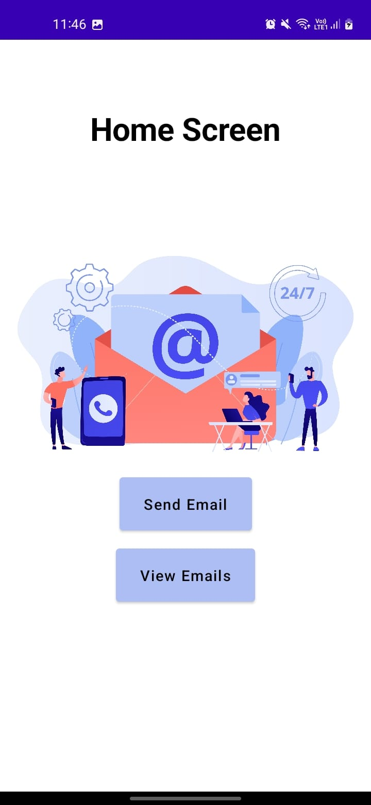

Slide 23
